Slide 1
Washington and Virginia
Of interest to 8th grade Latin and others themselves of interest

Slide 2
Enlightenment
Shift away from established religion, Ascension of Reason, Natural Law, Justice and the Return of Classicism: Neo-Classicism
1751-72, Diderot’s Encyclopedie codifies rule of science/nature in opposition to religion.
Johnson’s Dictionary, 1755
Newton, Locke, Swift and the aftermath of the Glorious Revolution

Slide 3
Neo-Classicism
1755, Johan J Winckelmann Thoughts on the Imitation of Greek Works in Painting and Sculpture. Leads charge against the Rococo claiming it decadent and baseless.
Return to academic painting, historical painting
The Grand Tour

Slide 4
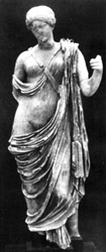

Slide 5
Vitruvius
De Architecturā
Engineer for Augustus’ artillery
Machines, aqueducts, hypocausts, Greek houses
Influential during Agrippa’s reconstruction of Rome?

Slide 6
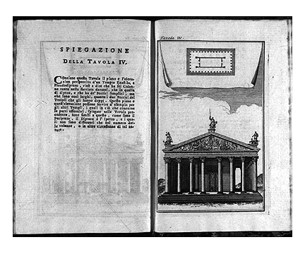

Slide 7
Basilica of Vicenza

Slide 8
Palazzo Chiericati

Slide 9
Villa la Rotunda

Slide 10
Neo-Palladianism
Neo-Classical Architectural Revival
Role of the Amateur Architect
Andrea Palladio,1570 I Quattro Libri dell'Architettura; architectural authority of Vasari’s caliber

Slide 11
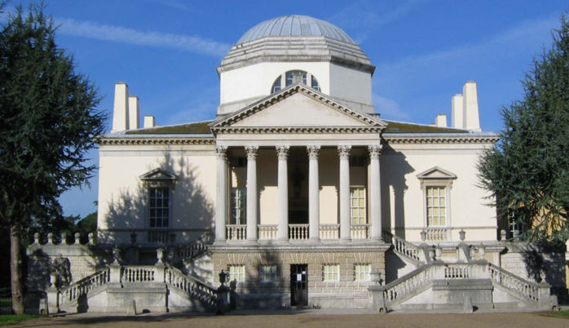
Neo-Palladianism: Lord Burlington. Chiswick House

Slide 12
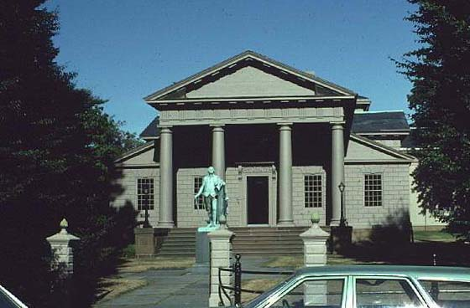
Peter Harrison. Redwood Library
Notes:
Newport, ri

Slide 13
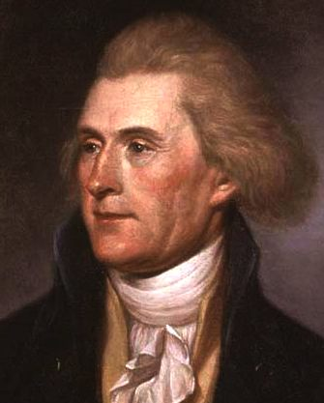
Thomas Jefferson

Slide 14
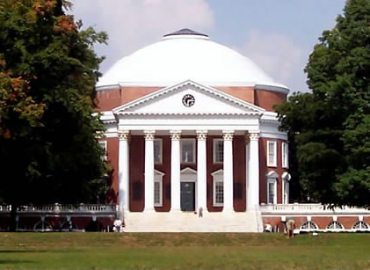

Slide 15
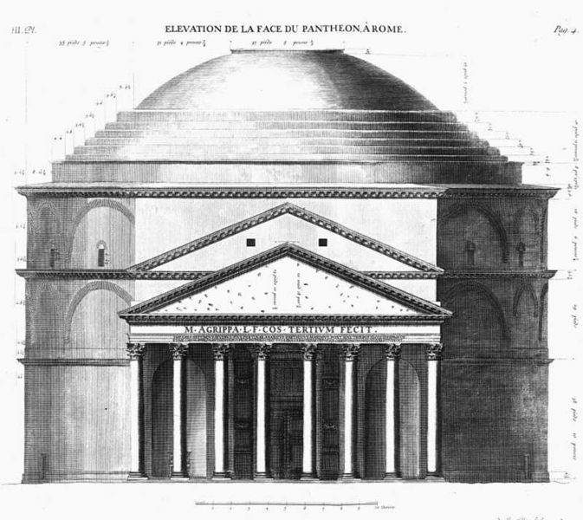

Slide 16
Monticello

Slide 17
Tour
http://explorer.monticello.org/

Slide 18
