Slide 1
Stone Age man
the discipline of History

Slide 2
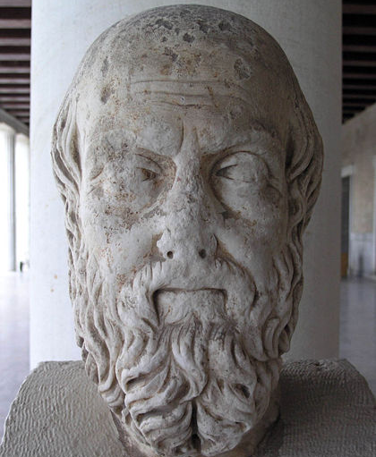
History
JIstoriva - inquiry, knowledge gained by investigation. (H. the act of judging or witnessing)
the scholarly study of what happened

Slide 3
sources
Primary
[1] Gallia est omnis divisa in partes tres, quarum unam incolunt Belgae, aliam Aquitani, tertiam qui ipsorum lingua Celtae, nostra Galli appellantur. Hi omnes lingua, institutis, legibus inter se differunt. Gallos ab Aquitanis Garumna flumen, a Belgis Matrona et Sequana dividit. Horum omnium fortissimi sunt Belgae, propterea quod a cultu atque humanitate provinciae longissime absunt, minimeque ad eos mercatores saepe commeant atque ea quae ad effeminandos animos pertinent important, proximique sunt Germanis, qui trans Rhenum incolunt, quibuscum continenter bellum gerunt. Qua de causa Helvetii quoque reliquos Gallos virtute praecedunt, quod fere cotidianis proeliis cum Germanis contendunt, cum aut suis finibus eos prohibent aut ipsi in eorum finibus bellum gerunt.

Slide 4
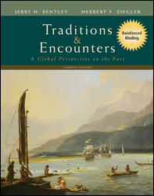
sources
Secondary

Slide 5
Prehistory
Archaeology
Anthropology

Slide 6
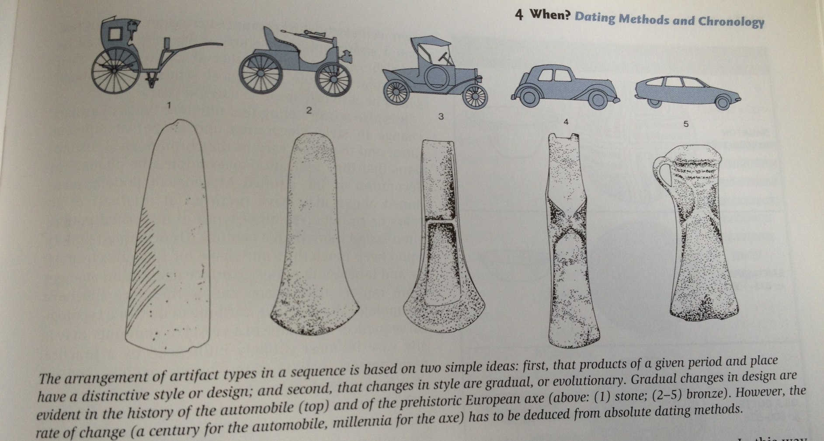
typologies
Renfrew, C (2004) Archaeology. Thames and Hudson; London

Slide 7
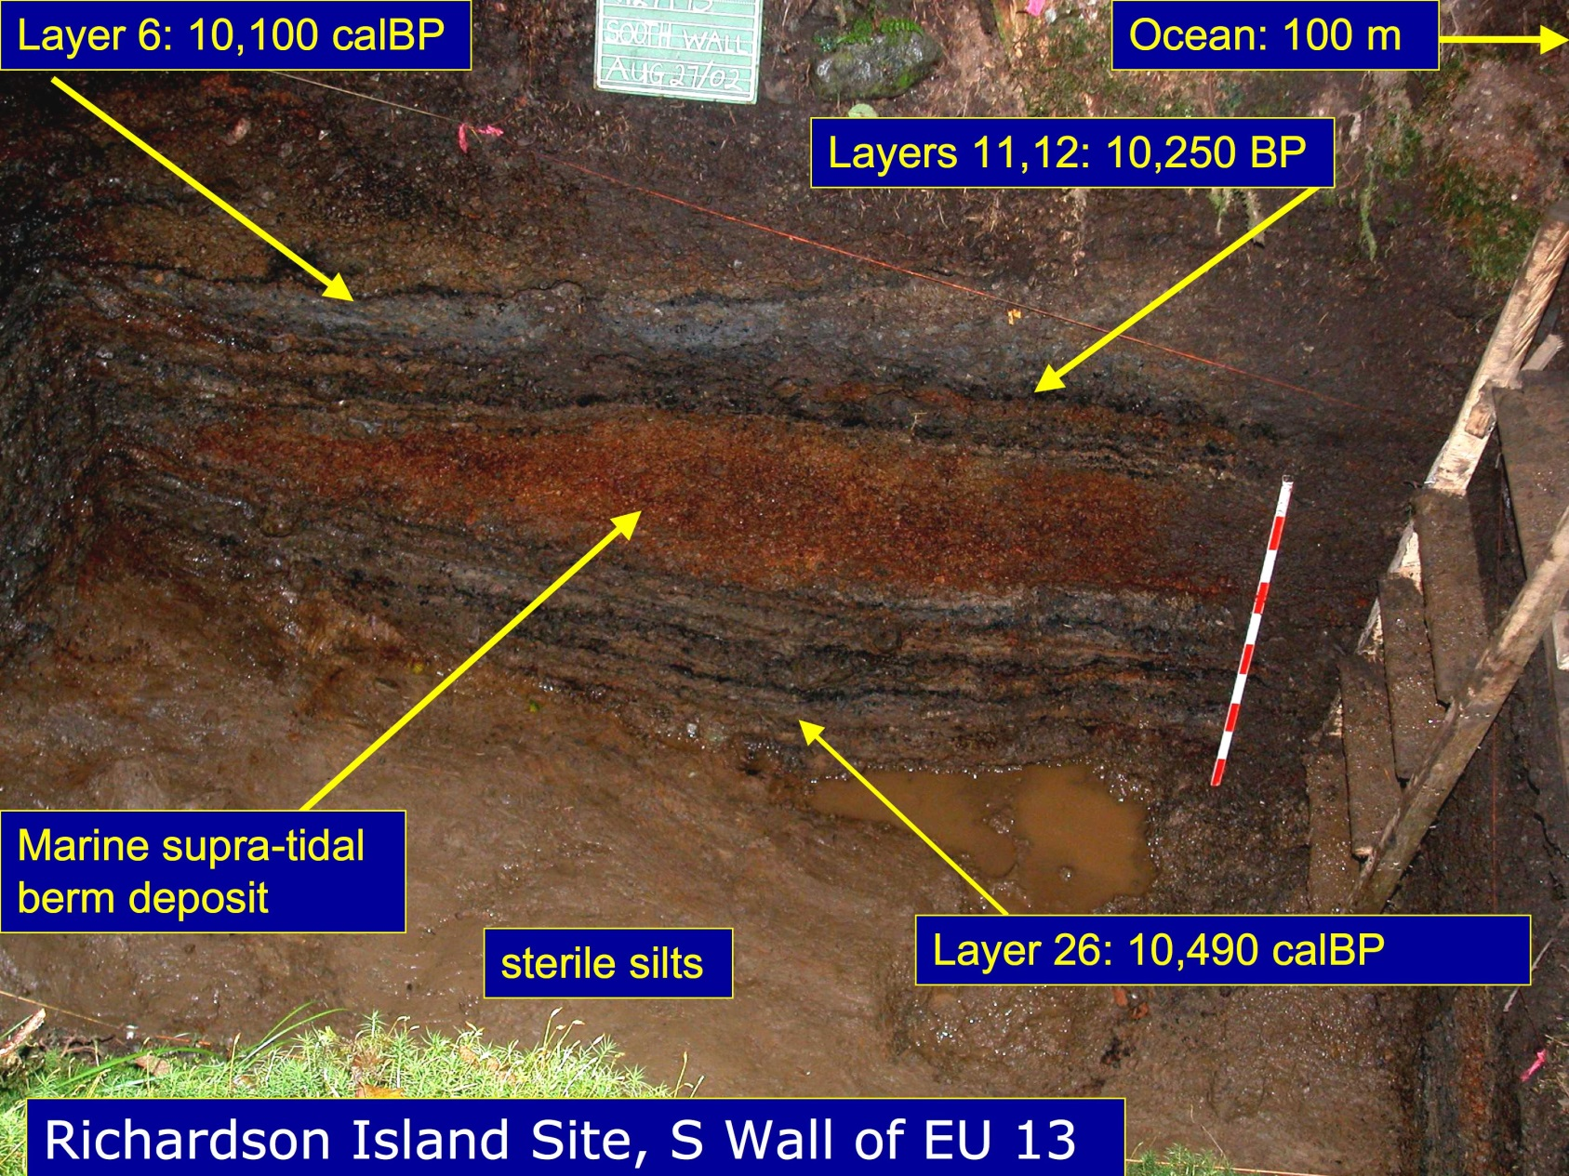
stratigraphy

Slide 8
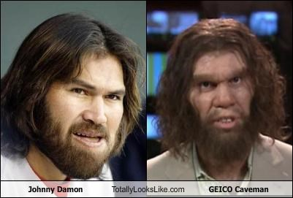


Basic chronologies
Paleolithic – 200,000 B.C.
Mesolithic – 13,000 B.C.E
  Jericho – 11,000 B.P.
Neolithic – 7,500 BC
  Sumer (writing) 3,400 BC

Slide 9
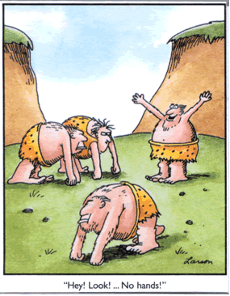
lucy
3.2 million years b.p.

Slide 10
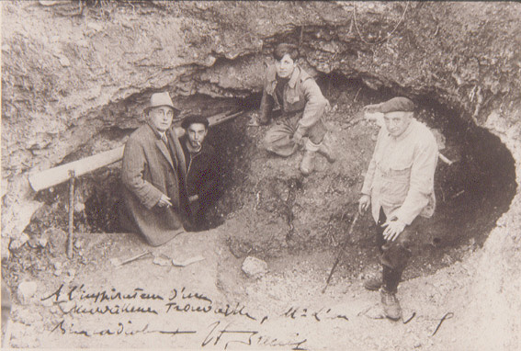
Lascaux

Slide 11
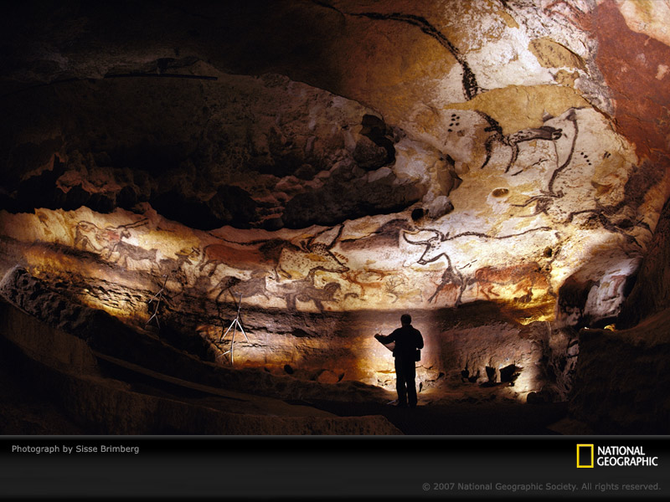

Slide 12
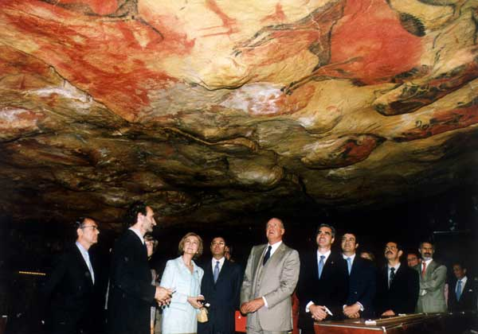
altamira

Slide 13
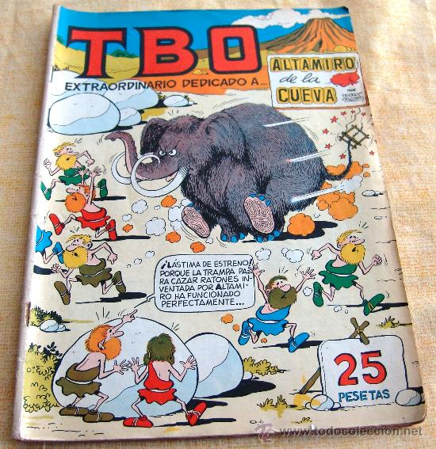

Slide 14
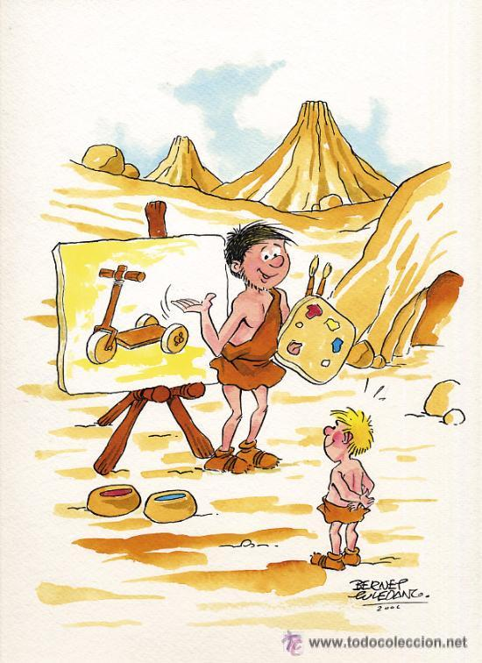

Slide 15
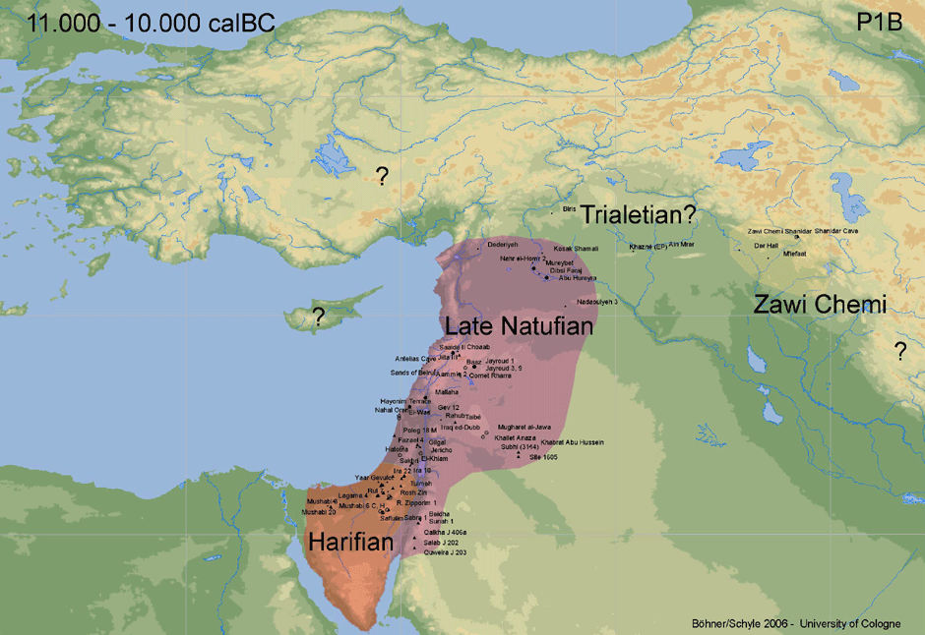
Mesolithic
13,000-10,000 BC

Slide 16
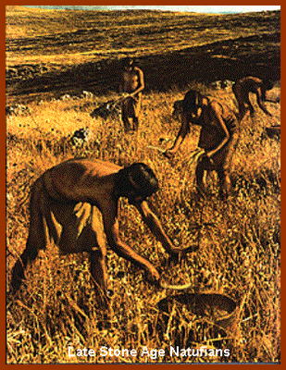
Natufian culture

Slide 17
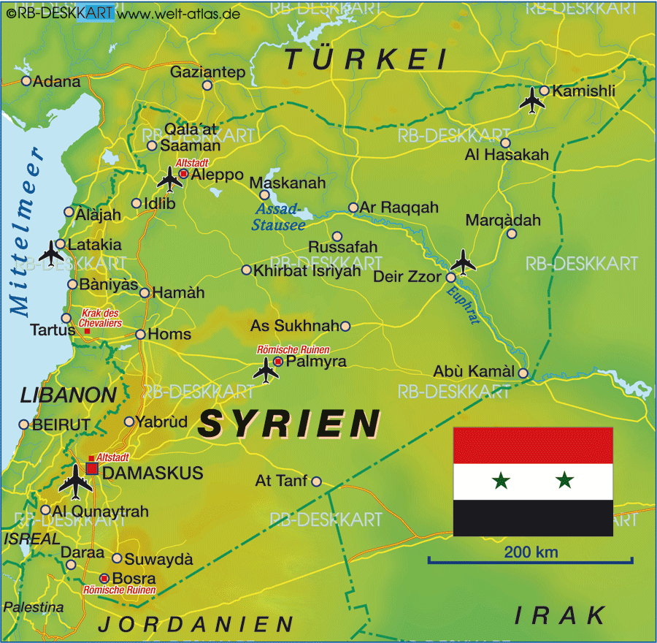
Tell Abu Hureyra

Slide 18
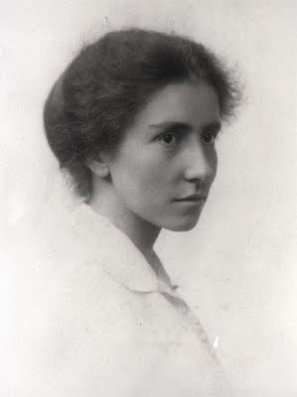
Shuqba cave
Dorothy Garrod

Slide 19
Neolithic
Çatalhӧyük – 7500 – 5700 BC
Sannai Maruyama – 3900 – 2600 BCE
Skara Brae – 3200 – 3000 BC

Slide 20
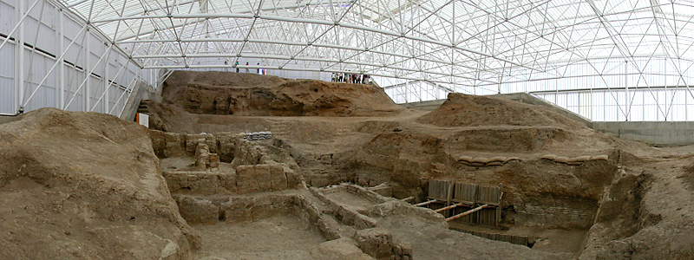
Çatalhӧyük – 7500 – 5700 B.C.
‘supernova of precocious urbanism’ – J. Mellaart

Slide 21
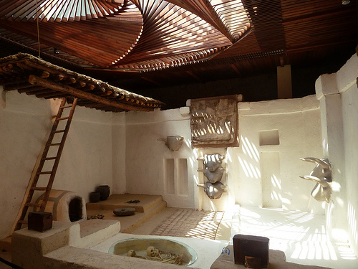

Slide 22
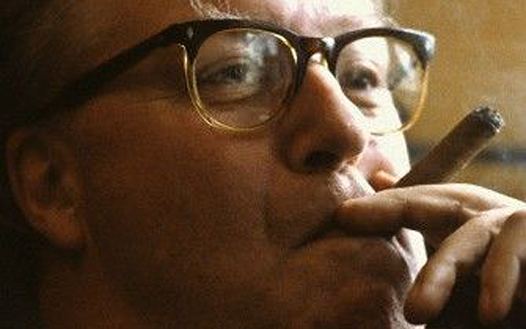
Çatalhӧyük – 7500 – 5700 B.C.
Jimmy Mellaart
Dorak Affair

Slide 23
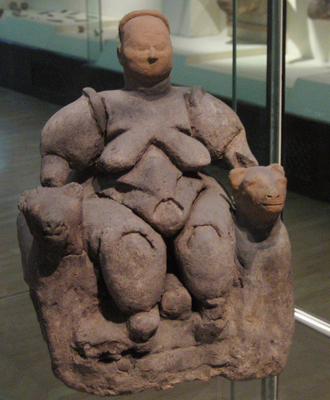
Anatolian mother goddess

Slide 24
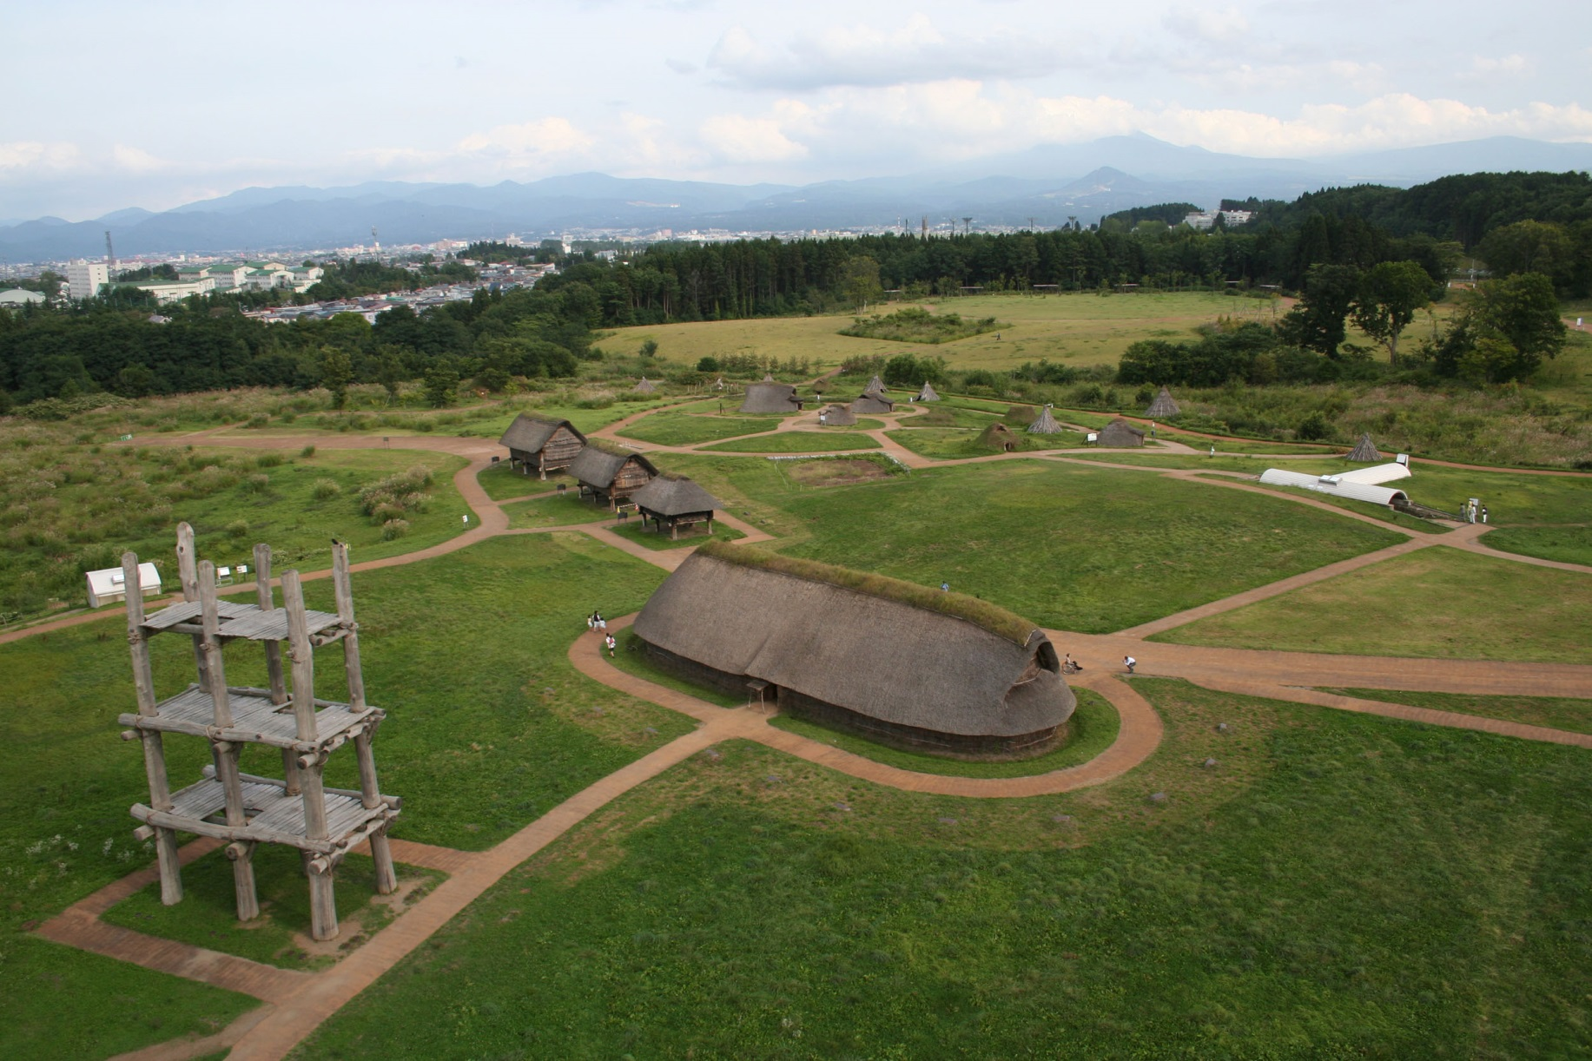
Sannai-Maruyama, – 3900 – 2600 BCE

Slide 25
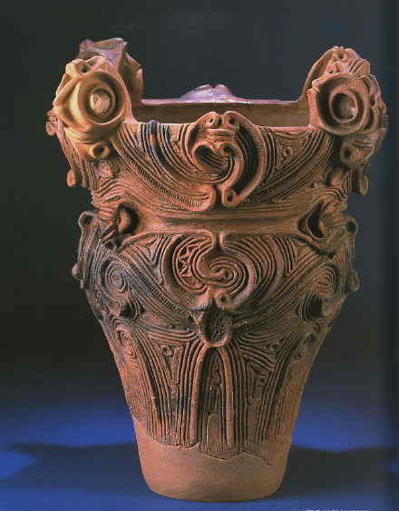
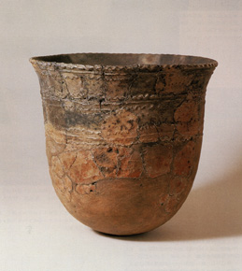
Jomon pottery

Slide 26
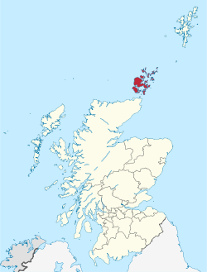
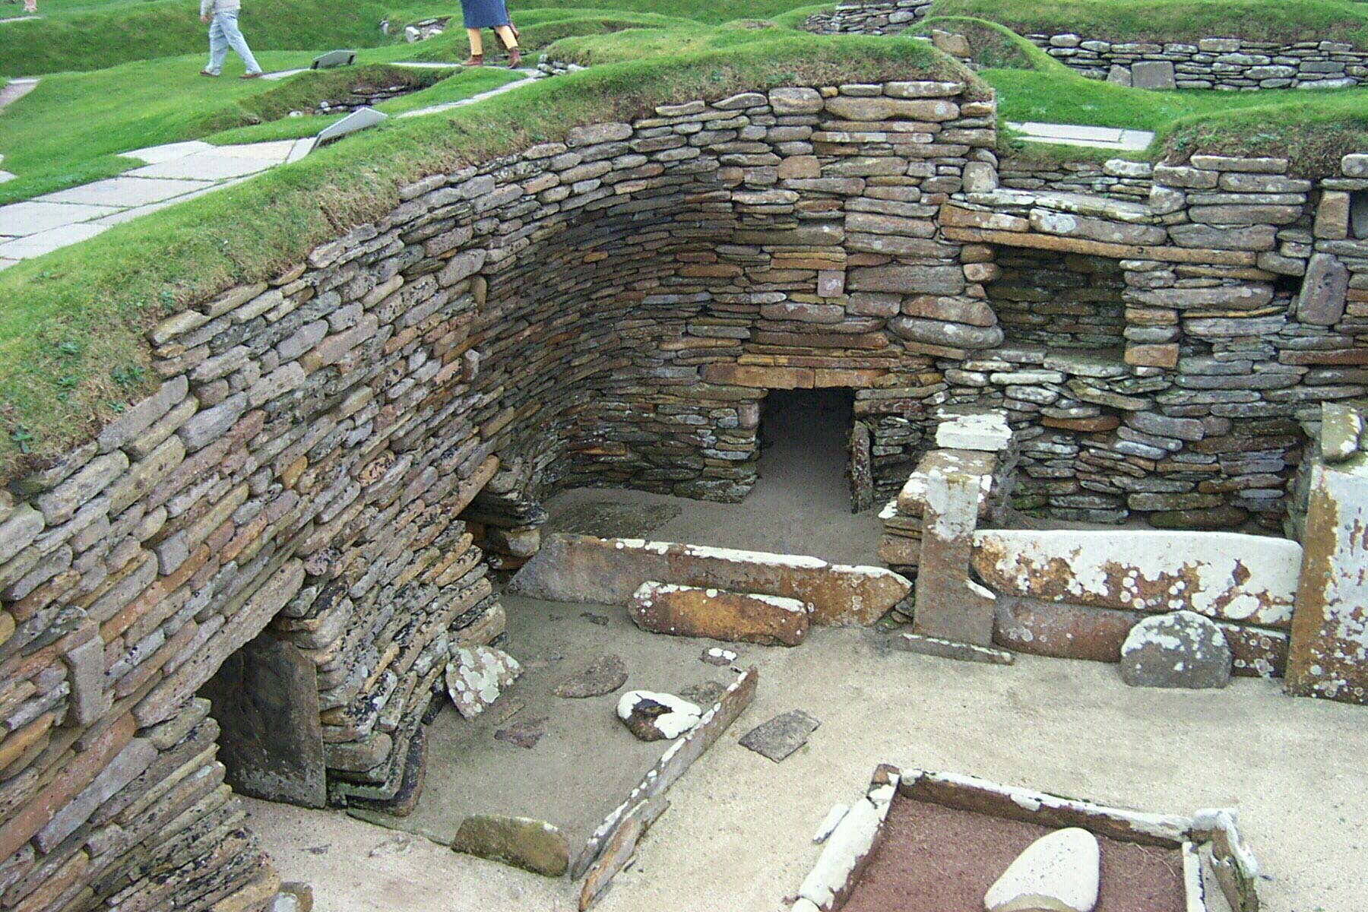
Skara Brae – 3200 – 3000 BC

Slide 27
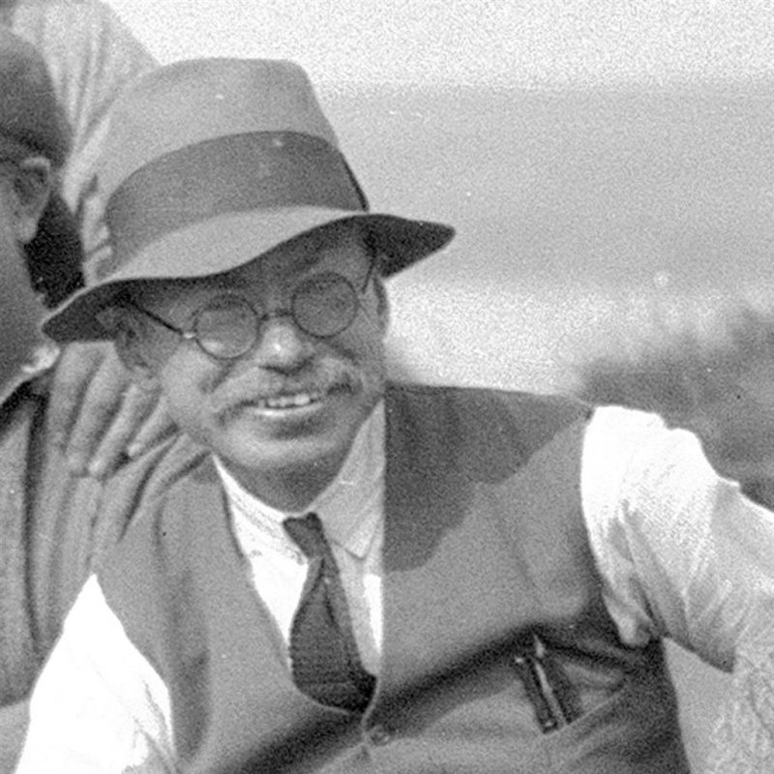
V gordon childe

Slide 28
Diffusionism
Anthropological term
Explains how ideas travel
  In the case of a ‘migration‘ ideas travel faster than people
  The Wheel throughout Indo-Europe
  The English suit today

Slide 29
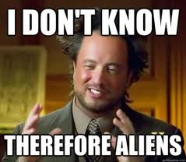

Slide 30
archaeology
Contributions to history, anthropology
A true historian must have a synthetic understanding of his subject
Great nations write their autobiographies in three manuscripts; the book of their deeds, the book of their words, and the book of their art…
- John Ruskin

