Slide 1
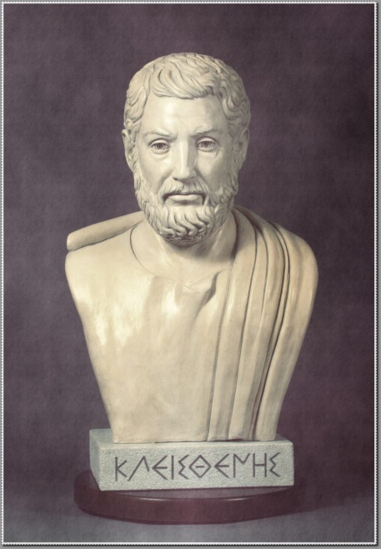
Cleisthenes and the
Alcmaeonidae
The Rise of Athenian Isonomia

Slide 2
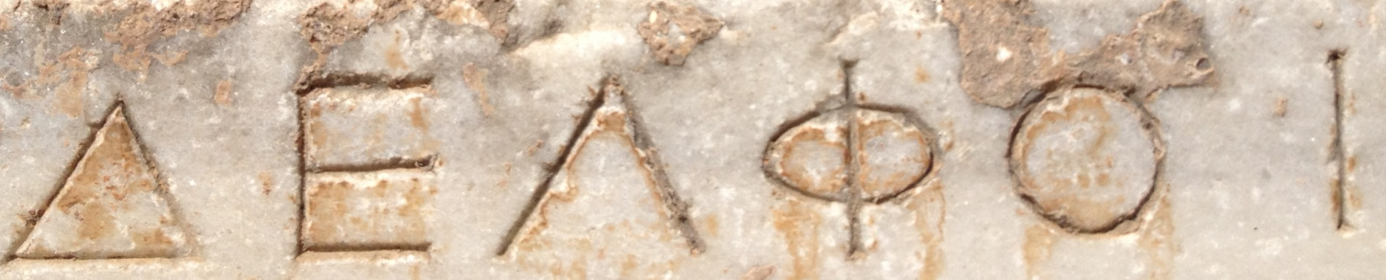
delphi
Reconstruction of the Temple of Apollo
'First, free the Athenians.'
Cleomenes and the Spartan Intervention
Athens has no government
- Aristocracy wants to revert to pre-Solonian times
- Farmer/hoplites want to retain powers
Let's allow the archon elections decide things?
Cleisthenes is defeated by Isagoras

Slide 3
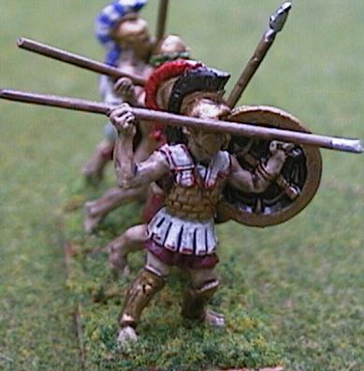
isagoras
Establishes Council of 300 – all aristocrats
Strikes names off the citizen list. All those families who came to Athens as skilled immigrants are sacked.
*Cleisthenes recruits the dissidents to his faction* and they vote him into office via the Ekklesia, bypassing the new council and including votes from recently ex-citizens
Isagoras recalls Cleomenes and the Spartans who expel Cleisthenes and the 700 families
Notes:
prohetaerizetai ton demon

Slide 4
Cleisthenes strikes back
Besiege the Cleomenes and his Spartans (and Isagoras) on the Acropolis.
Spartans get tired and cut a deal and go home.
The democrats take a city that is now prime for class revolution. It's a mad tinderbox worried about foreign invasion, too – a la Paris in the terror

Slide 5
Cleisthenes' reforms
10 tribes from 4
Each tribe is divided into 3 trittyes and divided geographically: city, coast, and middle earth
Every tritty is equal in population. So the number of each tribe is also equal as each of its thirds is equal.
As further means to break aristocratic power, aristocratic lands are separated from religious shrines in their old area via tritty boundaries
Deme (little town) is now the basic local governmental association.
Changes last names from patronymic to a deme name: No longer Cleisthenes son of Megacles, but Cleisthenes of Alopeke. Breaks easy marker of aristocratic lineage
Every tribe votes for polymarch
Role of Metics?

Slide 6
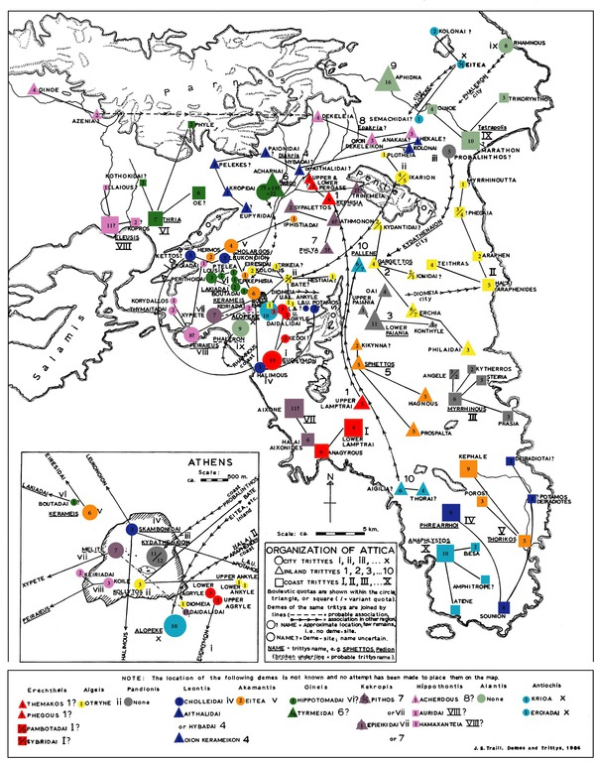
Camp J M, Archaeology of
Athens.

Slide 7
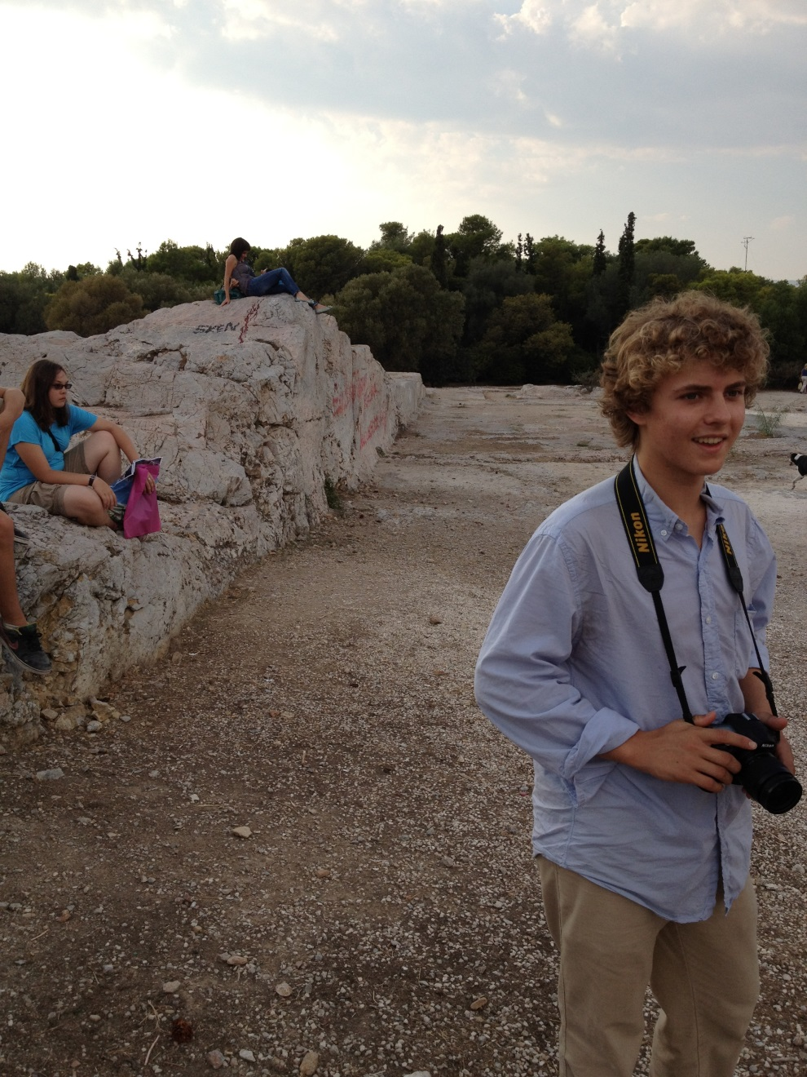
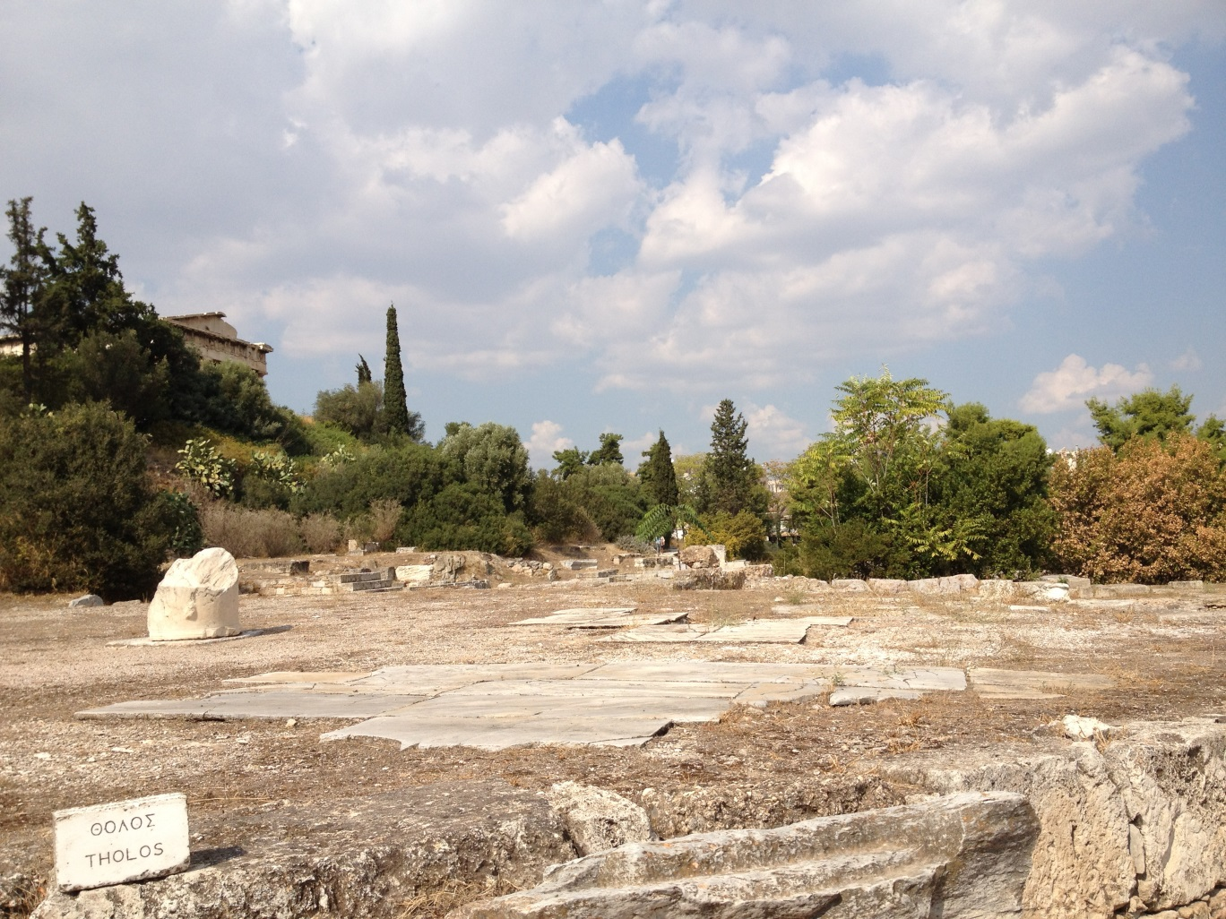
Boule and Ekklesia

Slide 8
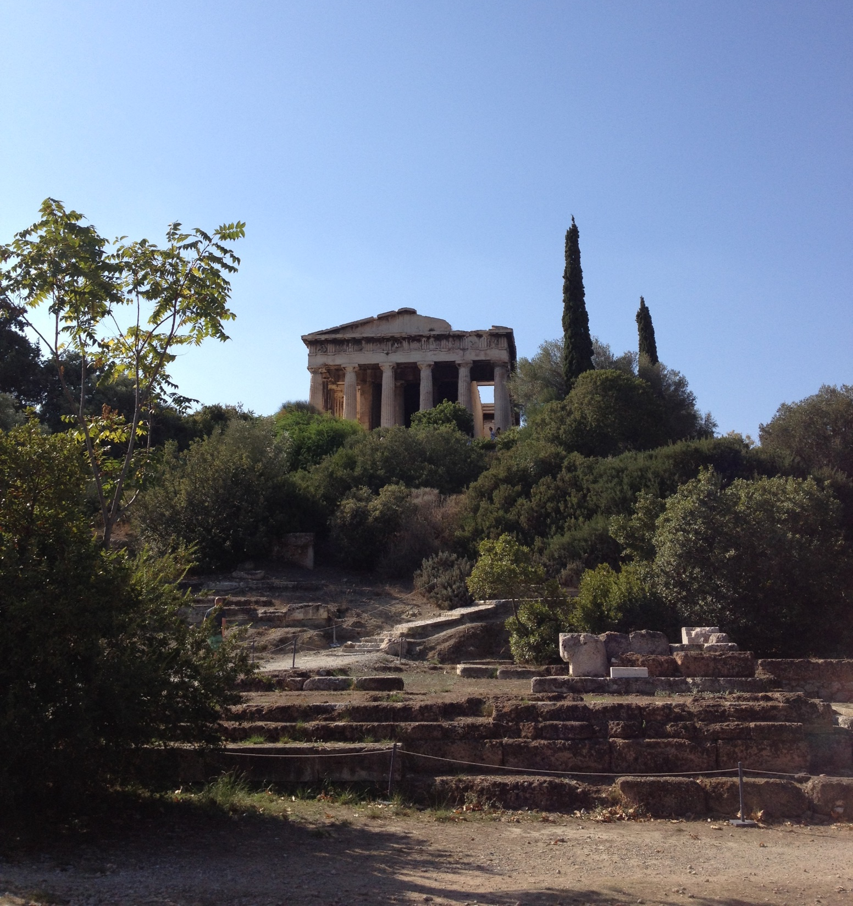

Slide 9
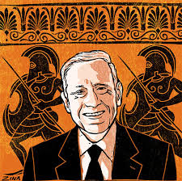
And one for the haters…
Yes, this democracy did exclude metics, women, slaves, and other non-citizens. Not every citizen has direct participation in all aspects of civic life…yet. Eg: Thetes.
'Many, many a scholar wants to denigrate ancient Athenian democracy and suggest it wasn't really democratic. That's to be deliberately blind to what's really happening. What you have here is a miracle.' – D Kagan

Slide 10
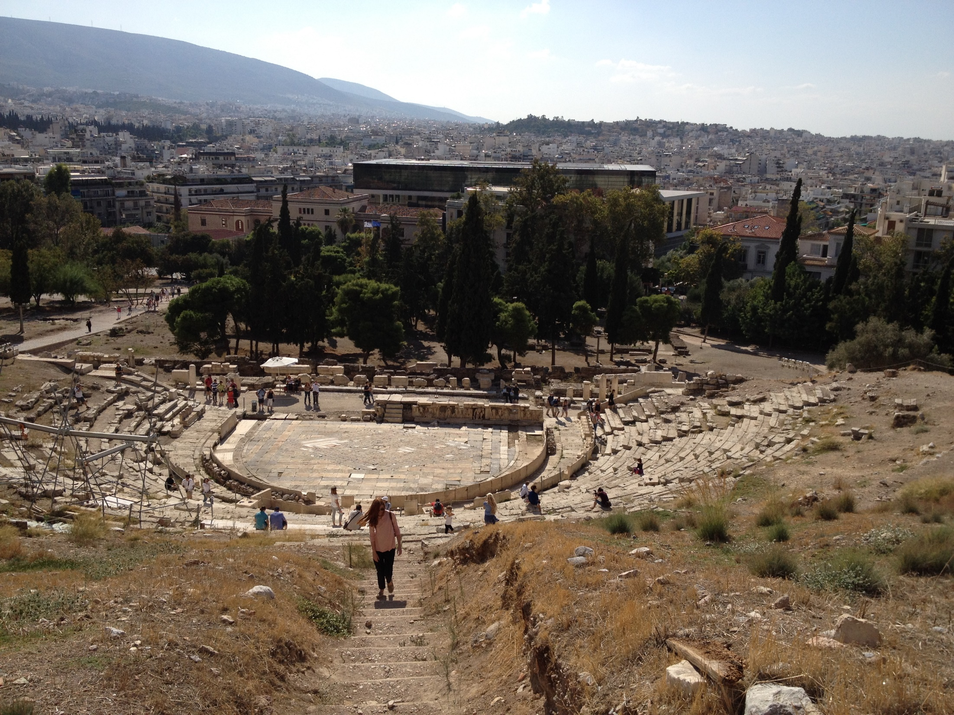
Role of theatre

Slide 11
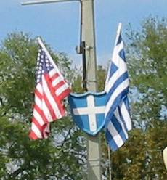
Eleutheria: isonomia and Isegoria
Herodotus says the Athenians call the new government an isonomia
Isonomia – equality before the law
Isegoria – equality of speech

Slide 12
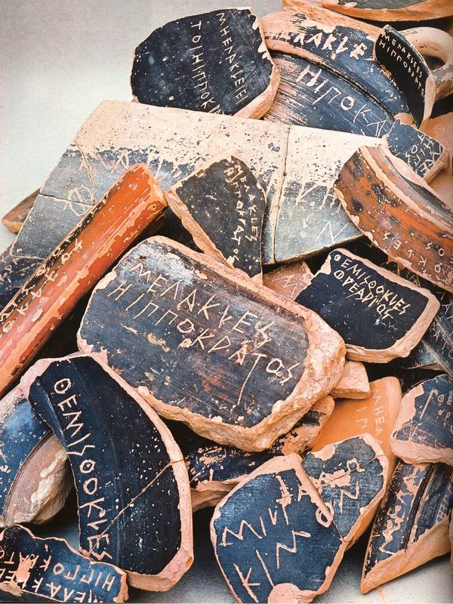
ostracism
Vote on whether to offer a vote on ostracism in January
In March, if they have one, voters enter through 1/10 gates in agora and drop off inscribed ostraka with name of the culprit. You can't leave until the vote is over. Silly election fraud.
The rule of 6,000. If there are fewer, no action taken. If there are more, then the guy with the most votes wins exile, regardless of how many he gets!
The winner of the ostracism ballot has to leave for 10 years.

