Slide 1
Egypt ok II.2
Fourth-Sixth Dynasties

Slide 2
Pyramid of Cheops (Khufu)
2545-2525
Giza
Wonder of the Ancient world
Tallest structure until the Eiffel Tower
800 tonnes of stone a day
Quarry for much of Saladin's Cairo

Slide 3
How d’you build it?
MOTIVATED WORKFORCE (14,500 total)
Teams of 20
10 teams make a Division (phile)
5 philes makes a gang
2 gangs are a crew!
The King’s Drunkards, Friends of Khufu
The Camp City – Free Beer, Meat (20 cows a day)

Slide 5
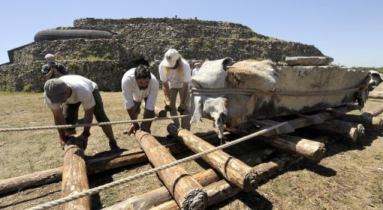
Yes, 12 people can move a 1 ton block on a sled

Slide 6
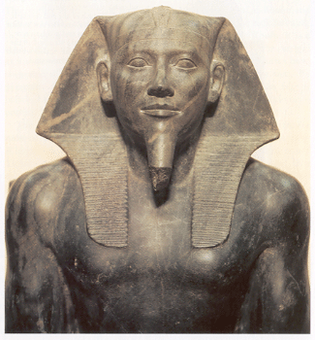
Pyramid of Chephren (Khafre)
Valley Temple
Causeway
Mortuary Temple

Slide 7
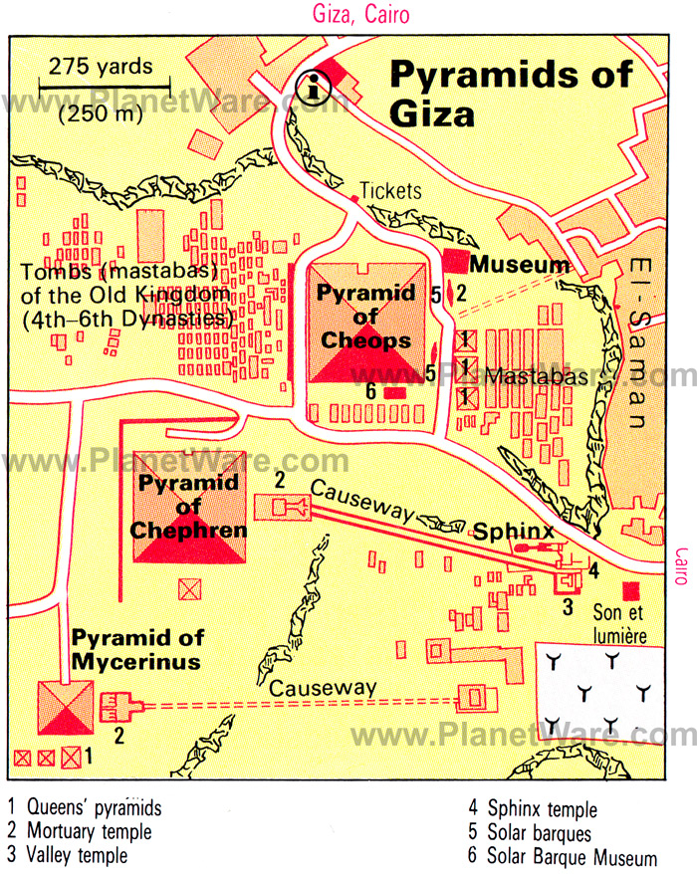

Slide 9
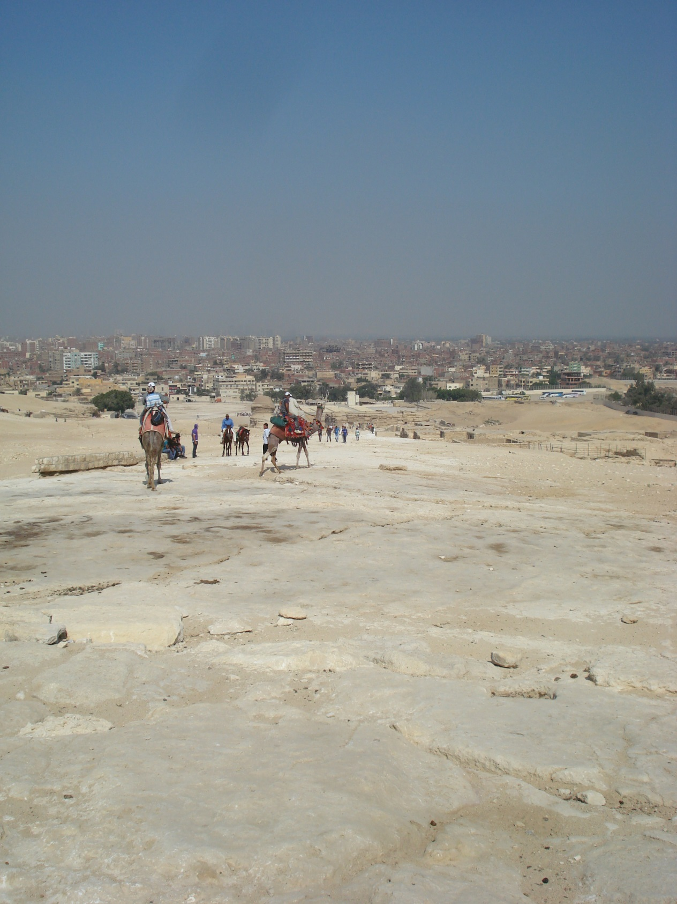

Slide 12
