Slide 2
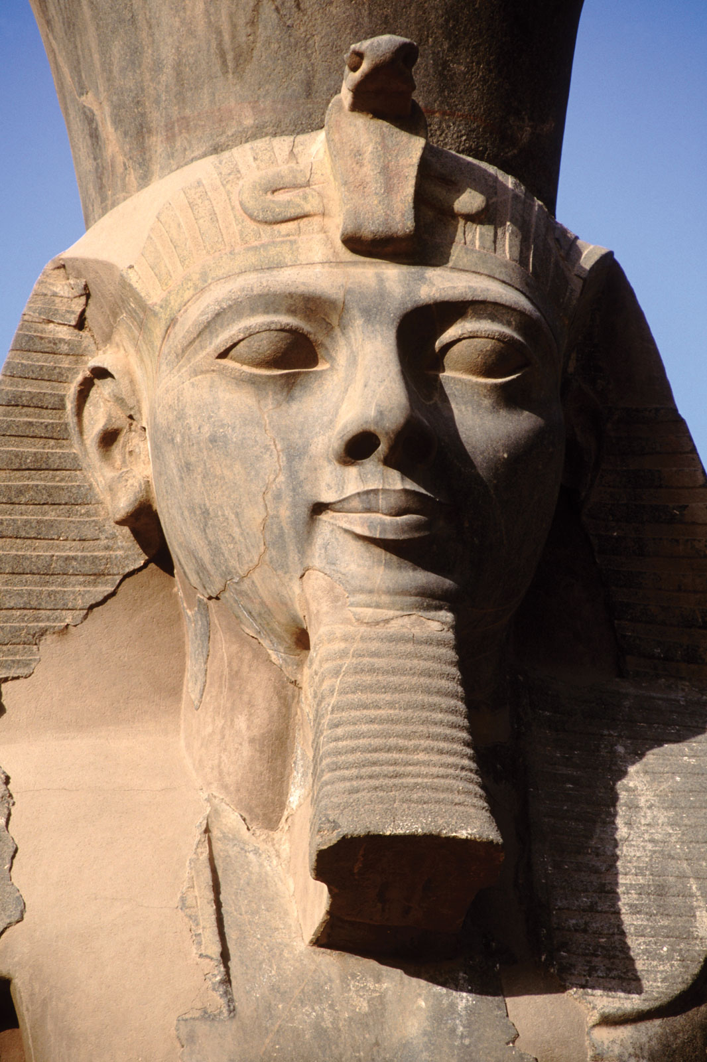
Ramses II 1279-13
Watch out, Hittites!
4 division army plus nomadic auxiliaries
Royal bodyguard, the Sherden (Trojans or Lydians, maybe Sardinians?)
Expedition leaves from Pi-Ramasses, new capital made on top of Hyksos capital, Avaris

Slide 3
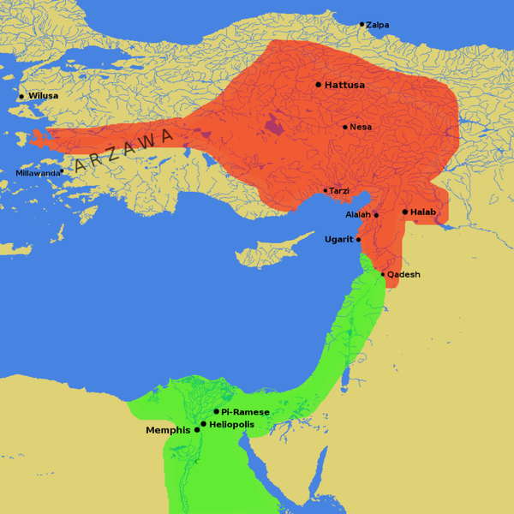

Slide 4
Kadesh, 1274
Protected by rivers on all sides
Bedouin report to Ramses that the Hittite army awaits him at Aleppo, all scared
Ramses sends the Amun division on forced march to get there asap
Btw – this is the first recorded battle in history

Slide 5
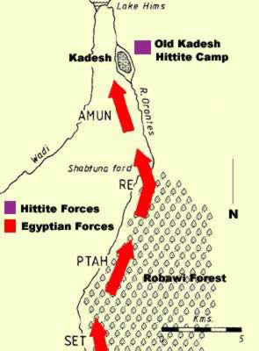

Slide 6
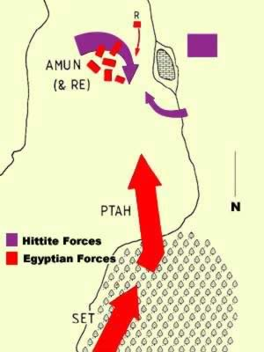
Ramses acts fast
The Sherden and Ramses rush to battle
Lighter Egyptian chariots plus lack of maneuverability in camp lets Ramses escape and defeat Hittite chariots

Slide 7
Aftermath of the chariot battle
Pyrrhic victory for Ramses
Egypt cannot press advantage and take the city – too many Hittites
Hittites and Muwatalli send envoys to Egyptians

Slide 8
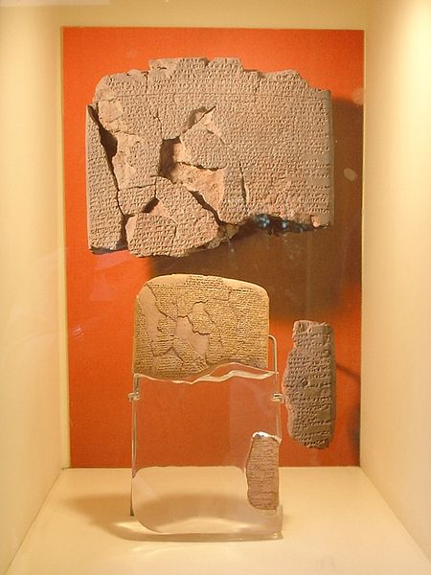
Treaty of Kadesh
First written international agreement
Sources from both sides call each other brother and pledge not to fight

Slide 9
Egypt takes Canaan, Hittites Syria
Ramses marries one of the Hittite princesses
Turns to chastising Nubia for good measure
Massive building program

Slide 10
Ramesseum

Slide 16
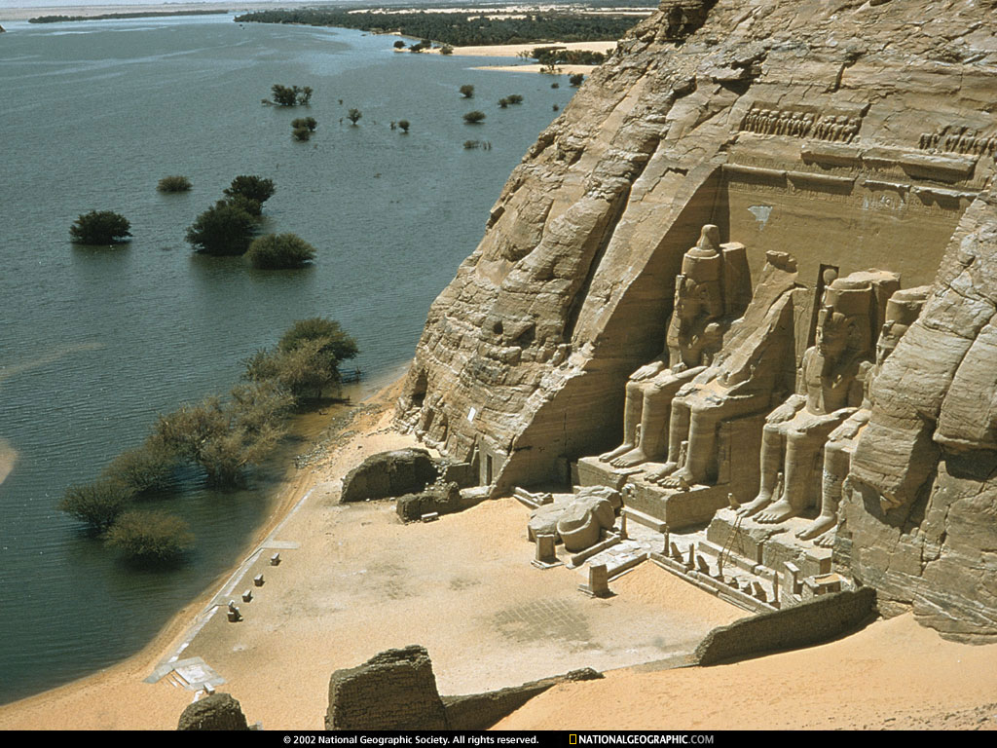
Abu Simbel -

Slide 17
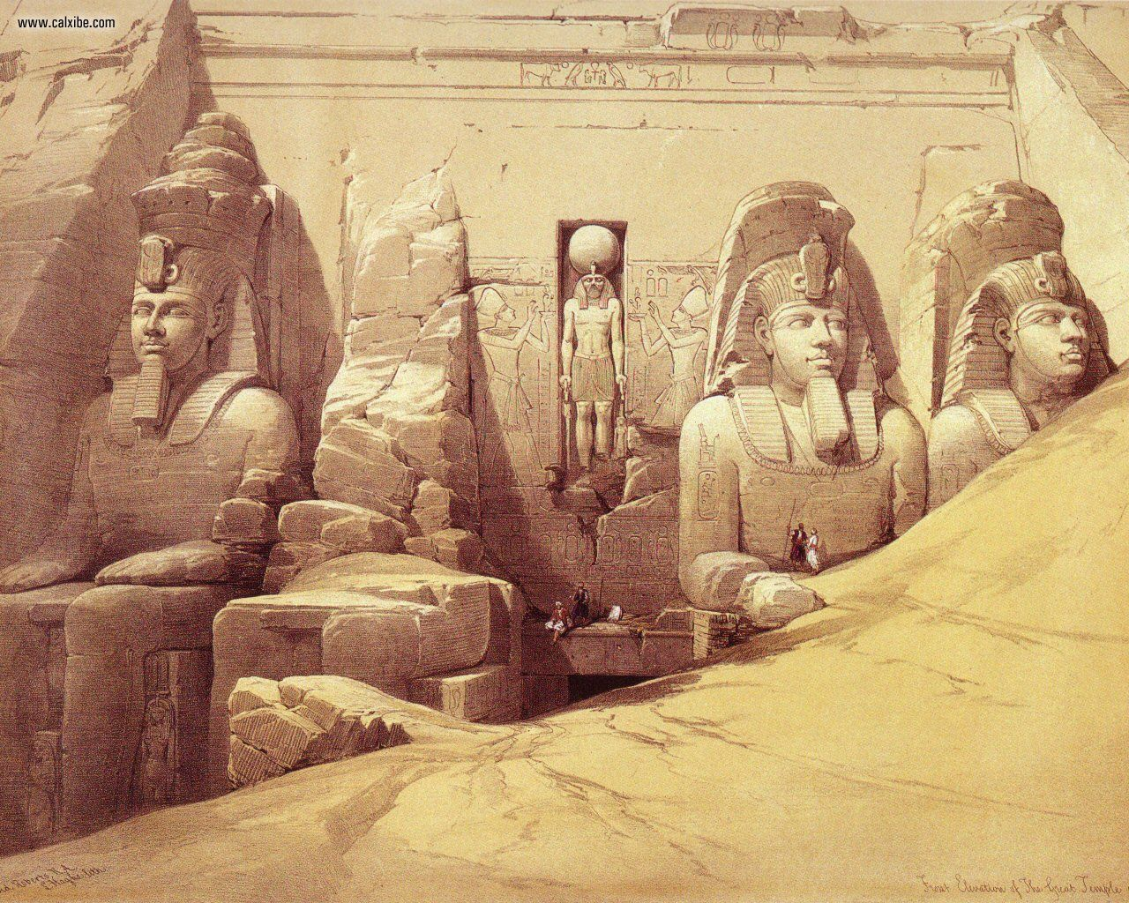

Slide 18
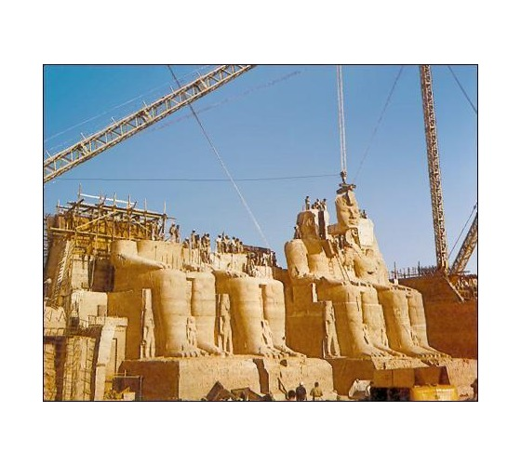

Slide 19
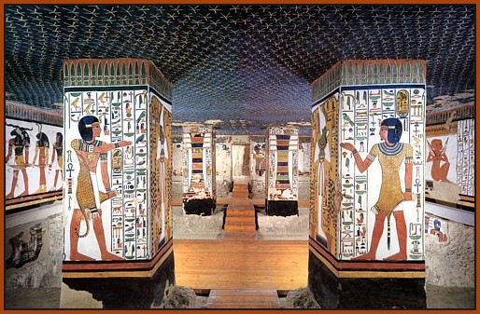
Tomb of Nefertari
VQ66 – largest and best preserved

Slide 20
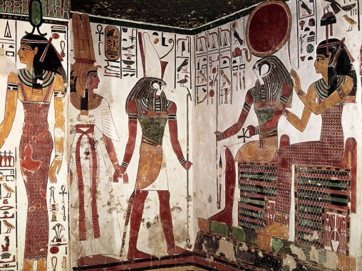

Slide 21
Ozymandias (Usermaatre)
I met a traveler from an antique land Who said: Two vast and trunkless legs of stone Stand in the desert. Near them, on the sand, Half sunk, a shattered visage lies, whose frown, And wrinkled lip, and sneer of cold command, Tell that its sculptor well those passions read Which yet survive, stamped on these lifeless things, The hand that mocked them and the heart that fed: And on the pedestal these words appear: "My name is Ozymandias, king of kings: Look on my works, ye Mighty, and despair!" Nothing beside remains. Round the decay Of that colossal wreck, boundless and bare The lone and level sands stretch far away.

Slide 23
Legacy of Ramses
Everyone wants to be him
Massive building projects
Dynasty 20
Fall of Hittites to Assyrians, Scythians, etc
Beginning of the Aegean Bronze Age Collapse

