Slide 1
Ancient Near East
Assyria

Slide 2
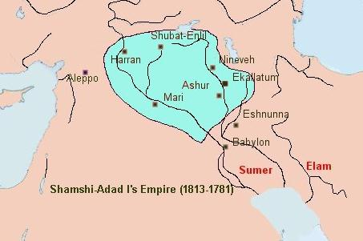
Ashur (city and god)
City founded by Semitic tribes (from Nineveh?)
Following the Sargon's Akkadian Empire, and the 3rd dynasty of Ur (Sumerian Renaissance) Mesopotamia splits into two regions Assyria to the North, Babylon in the South.
1813 – Shamshi-Adad I, overthrows Akkadians
Takes Mari, over to Anatolia, too, but Hammurabi's Babylon takes Assyria
Tribute to Babylon…
briefly…

Slide 3
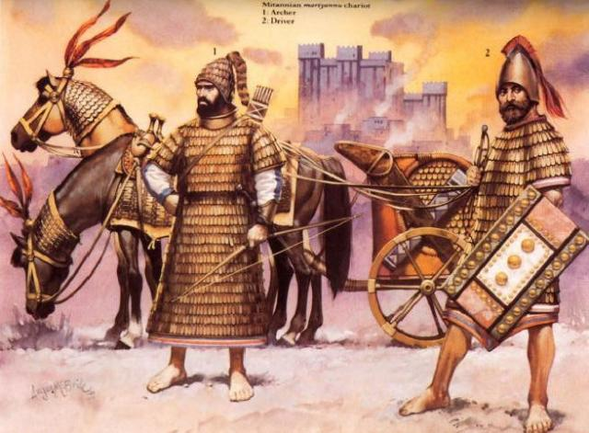
Babylonia sacked by the Hittites!
But the Metanni of Anatolia sack Ashur, become hegemon of Assyria until 1393

Slide 4
Ashur-uballit I
Defeats the Mitanni with Egyptian help
Establishes Assyrian rule in Assyria, 1393
Annexes lands from Hittites, Arameans, and other neighbors

Slide 5
Shalmanesar 1274
Continued imperialistic expansion
Shalmanesar begins policy of deportation of defeated peoples so this way the Mitanni are eventually dismissed with no cohesive organization or identity.

Slide 6
Tukulti-Ninurta I
Battle of Nihriya, defeats the Hittites, 1245
Conquers Babylonia – makes heaps of corpses, defiles temples, fills in canyons with bodies, etc.
'King of Sumer and Akkad' Sargon
Babylon revolts and Assyria in brief decline

Slide 7
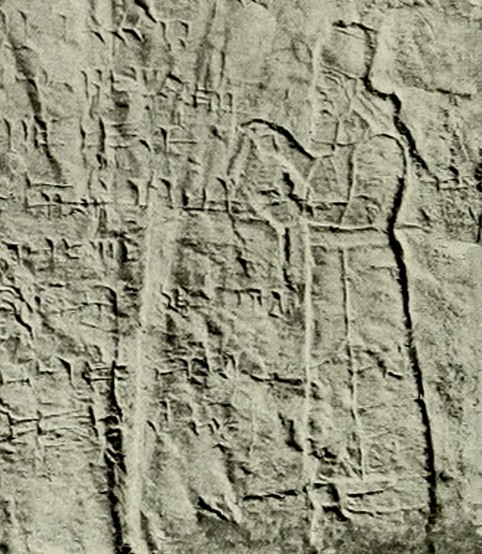
1115-1076 Tiglath-Pileser I
Establishes first Assyrian empire
1113 against the Phrygians, then collects tribute against Phoenicia. Also Babylonian conquests.
Ashur decked out: royal palace refurbished, royal garden with menageries, temples refitted.

Slide 8
Neo-Assyrian Empire, 911 - 612
Zenith of power of the Assyrians
911- Conquest of Babylon
612 - Fall of Nineveh
Iron weaponry
Battering ram tanks
Spoke wheels
Cavalry

Slide 9
Ashurnasipal II
Sadistic yet effective monarch
skins all against him, buries people alive, skins many more, cuts off ears and fingers, burns maidens in fire, drapes skins over corpses
'with their blood I dyed the mountain red…and erected a tower before their city with heads'
Collects tribute from about everyone, otherwise it's skin on walls!
Notes:
Albert Kirk Grayson, Assyrian Royal Inscriptions, Part 2: From Tiglath-pileser I to Ashur-nasir-apli II
(Wiesbaden, Germ.: Otto Harrassowitz, 1976)

Slide 10
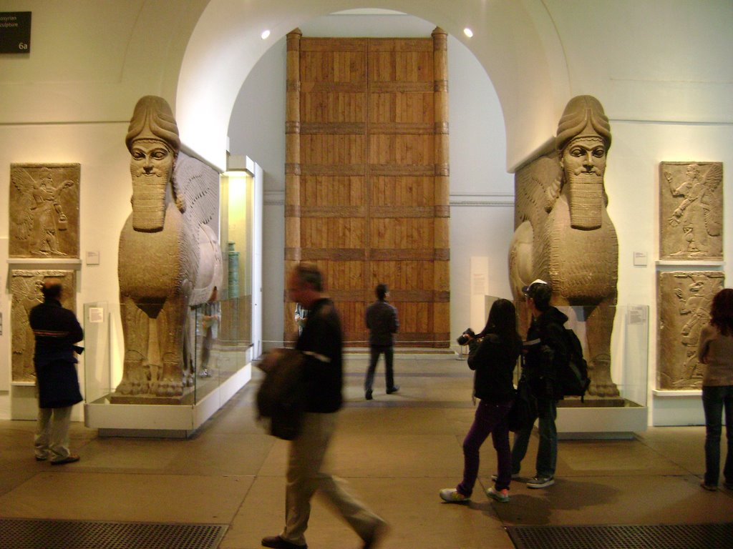
Temple of Mamu at Balawat
Balawat Gates
Lamassu

Slide 11
Balawat

Slide 12
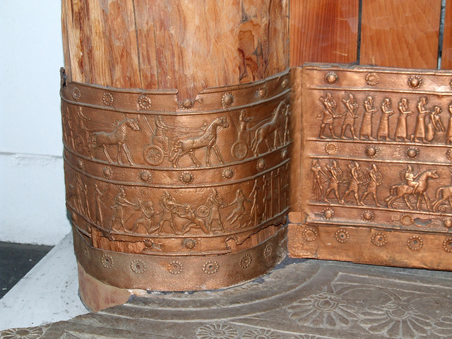

Slide 14
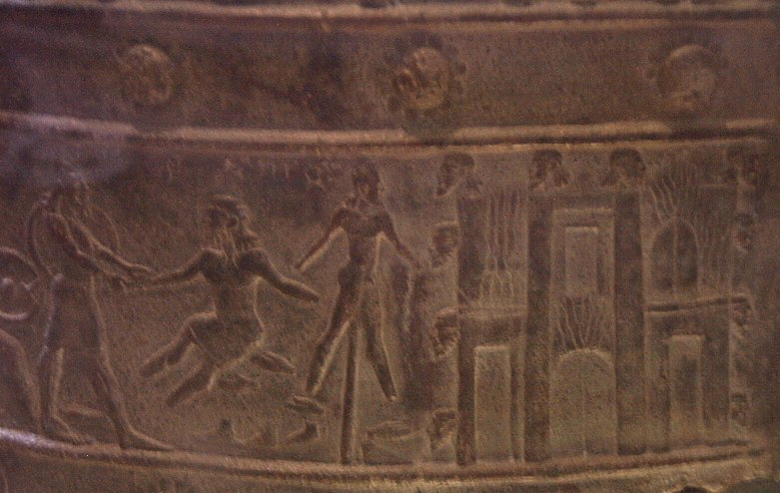

Slide 15
Shalmaneser III
takes Babylonia, fights Qarquar (853) against 12 nations (basically everyone you've heard about so far) and claims tribute from the Levant in general.
Black Obelisk
Dismembers hands and feet; hands & heads on trees
Heads on spikes

Slide 16
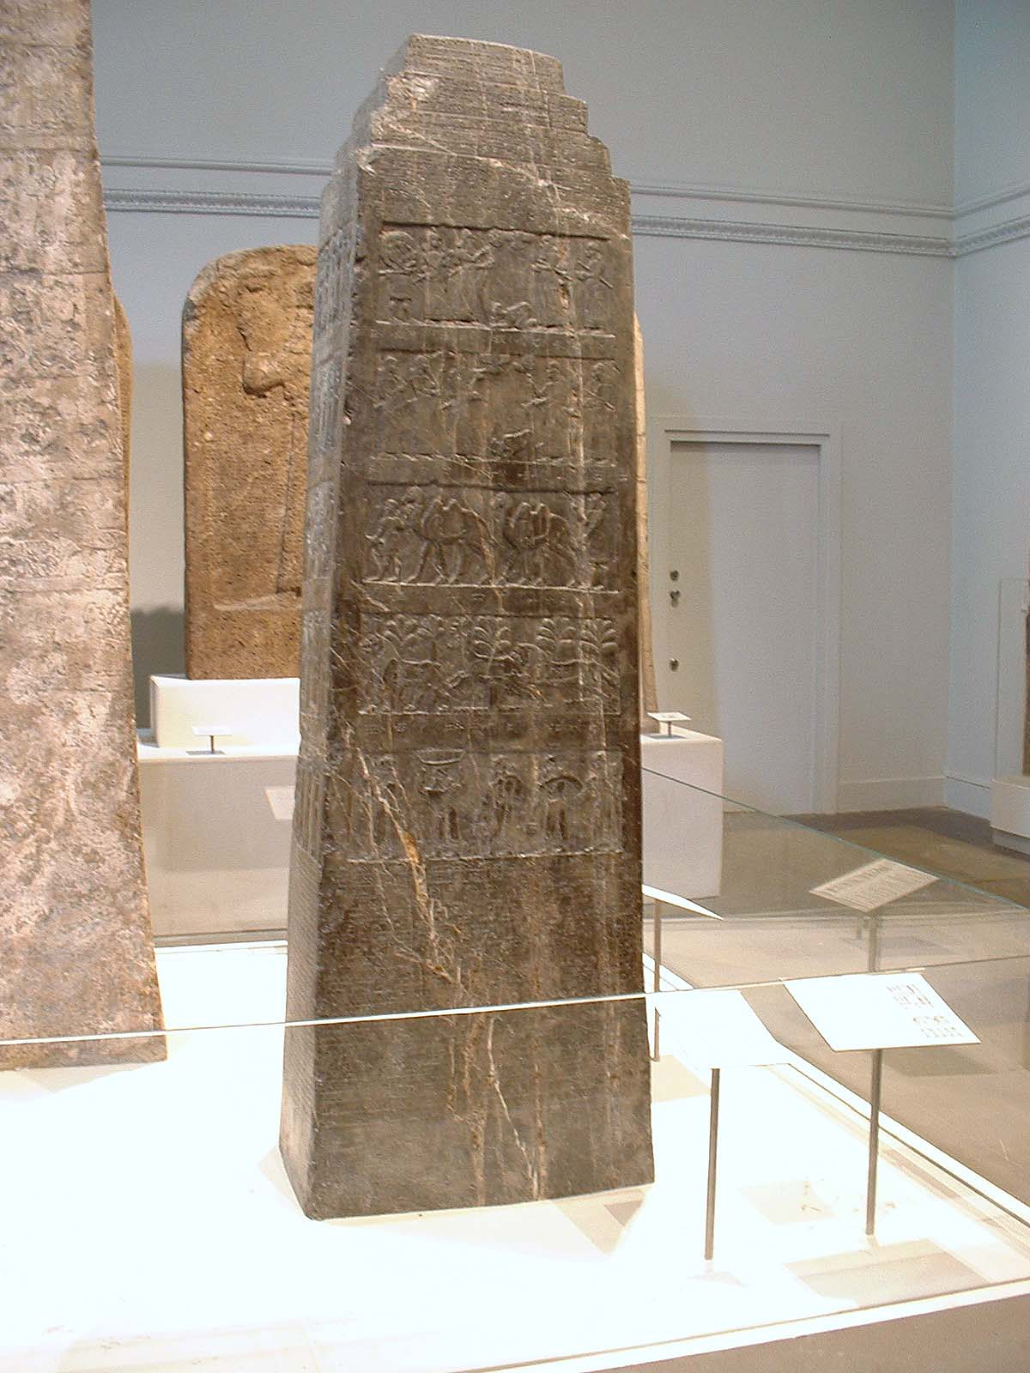
Black Obelisk
Records booty: monkeys, elephants, rhinoceroi.
5 tribute scenes, Jehu of Isreal
http://www.britishmuseum.org/explore/highlights/highlight_image.aspx?image=ps279539.jpg&retpage=19080

Slide 17
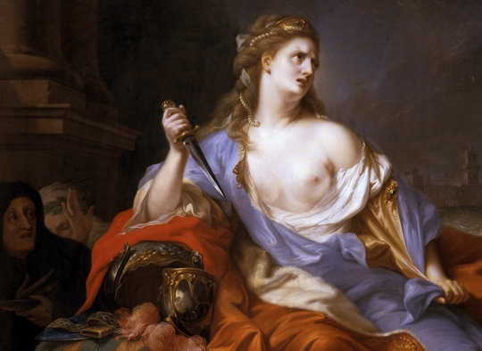
Pu'mayyaton (Pygmalion)
King of Tyre who murders his brother-in-law to get gold to pay Assyria
Lies about it to his sister, Elissa, who takes off for North Africa.
To Tunisia, or Kar'hadasht, where she is given land to fit under a bull's hide.
Dux femina facti

Slide 18
Tiglath-Pileser III, 745

Slide 19
Tiglath-Pileser III, 745
Seizes power in coup, kills former royalty
Inherits bulky administration and plunder economy
begins taxation, mass deportations
Cuts bureaucracy and uses eunuchs for governors
World's first professional, year-round army
Advances cavalry tactics, and marches on Israel and leaves after being paid ungodly amounts of silver (33.5 tonnes)

Slide 20
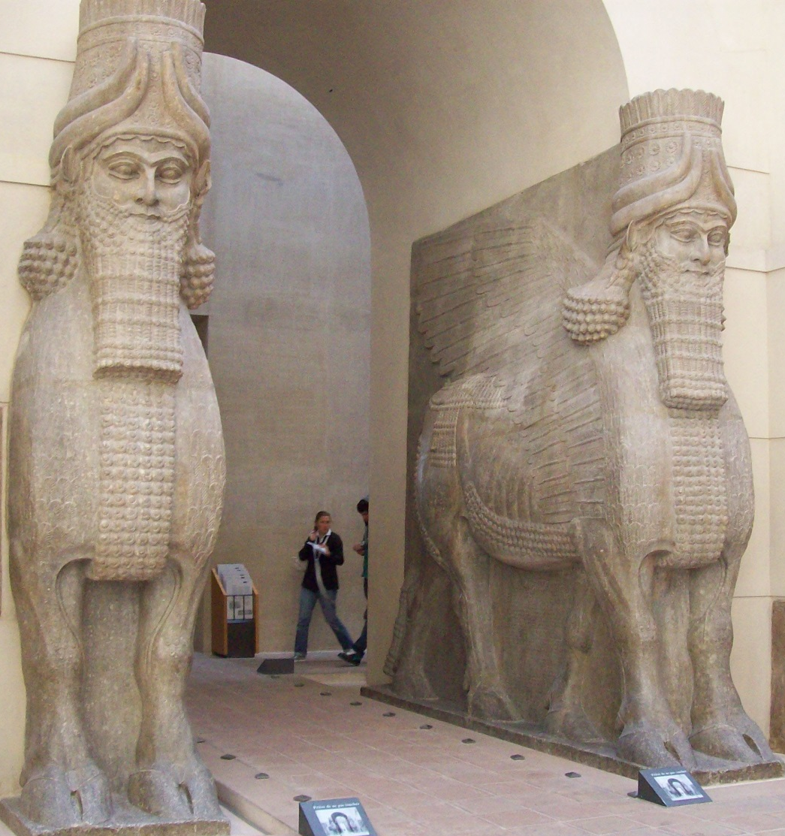
Sargon II
Conquests in Anatolia, Levant
Moves capital to Nineveh
Dur-Sharrukin (Khorsabad)
721, Takes Israel
First diaspora

Slide 21
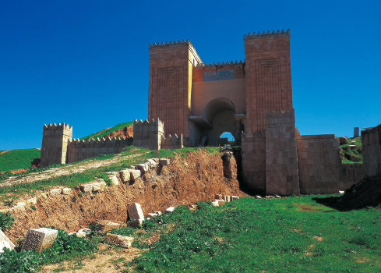
Sennacherib
Raises Babylon & Israel but siege of Jerusalem fails
'The palace without rival' Nineveh, substantial gardens
City walls
Aqueduct at Jerwan, 690
Patricide, mad at destruction of Babylon
http://www.telegraph.co.uk/news/worldnews/middleeast/iraq/10039773/Hanging-gardens-of-Babylon-were-not-in-Babylon.html

Slide 22
'The Destruction of Sennacherib'
The Assyrian came down like the wolf on the fold, And his cohorts were gleaming in purple and gold; And the sheen of their spears was like stars on the sea, When the blue wave rolls nightly on deep Galilee.
Like the leaves of the forest when Summer is green, That host with their banners at sunset were seen: Like the leaves of the forest when Autumn hath blown, That host on the morrow lay withered and strown.
For the Angel of Death spread his wings on the blast, And breathed in the face of the foe as he passed; And the eyes of the sleepers waxed deadly and chill, And their hearts but once heaved, and for ever grew still!
And there lay the steed with his nostril all wide, But through it there rolled not the breath of his pride; And the foam of his gasping lay white on the turf, And cold as the spray of the rock-beating surf.
And there lay the rider distorted and pale, With the dew on his brow, and the rust on his mail: And the tents were all silent, the banners alone, The lances unlifted, the trumpet unblown.
And the widows of Ashur are loud in their wail, And the idols are broke in the temple of Baal; And the might of the Gentile, unsmote by the sword, Hath melted like snow in the glance of the Lord.

Slide 23
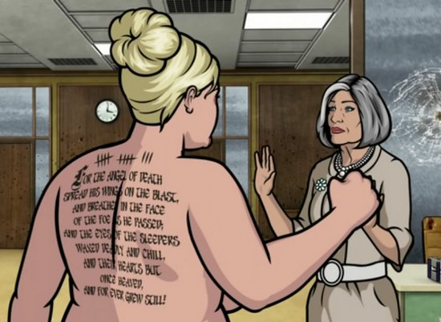

Slide 24
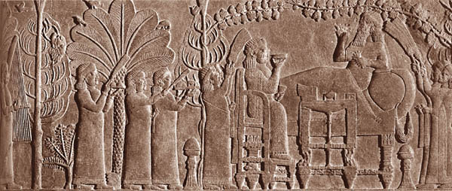
Assyrian Mores
Warlike: human leather, amputations, decapitations, heads on spikes
'The Repose of Ashurbanipal'

Slide 25
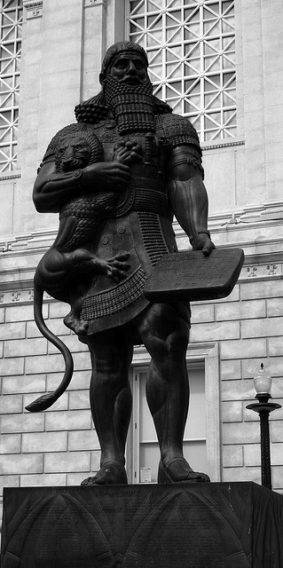
Ashurbanipal (Sardanapalus?)
Chained enemy kings and made them live in doghouse
Last powerful king of Assyria
Height of Assyrian Empire Overexpansion, ca 640
Library of Sardanapalus, Akkadian, Sumerian, Aramaic
Enuma Elish (Epic of Creation), Epic of Gilgamesh
San Francisco, Asian Art Museum

Slide 26
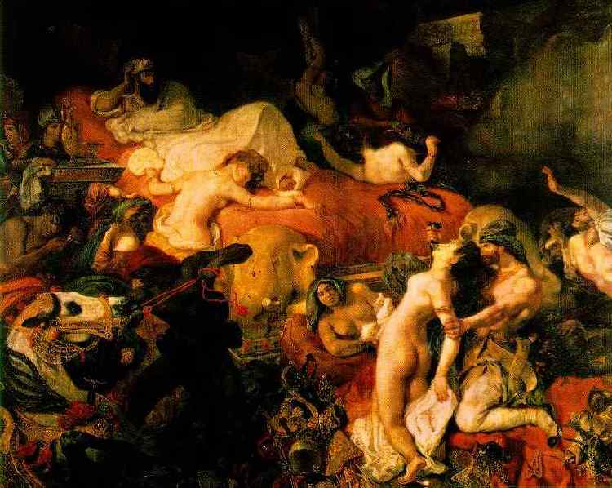
Sardanapalus
Legendary hedonistic king of Assyria
Routed in battle, with city falling burns himself and others
Byron, Delacroix

Slide 27
Battle of Nineveh 612
Babylonians and Medes
Destruction of the world's richest city follows
Rise of the Medes

